Slide 1
Climbing ahead, falling behind: social mobility across time and space
Week 7
June 10, 2024
Dr. Louis Henderson

Slide 2
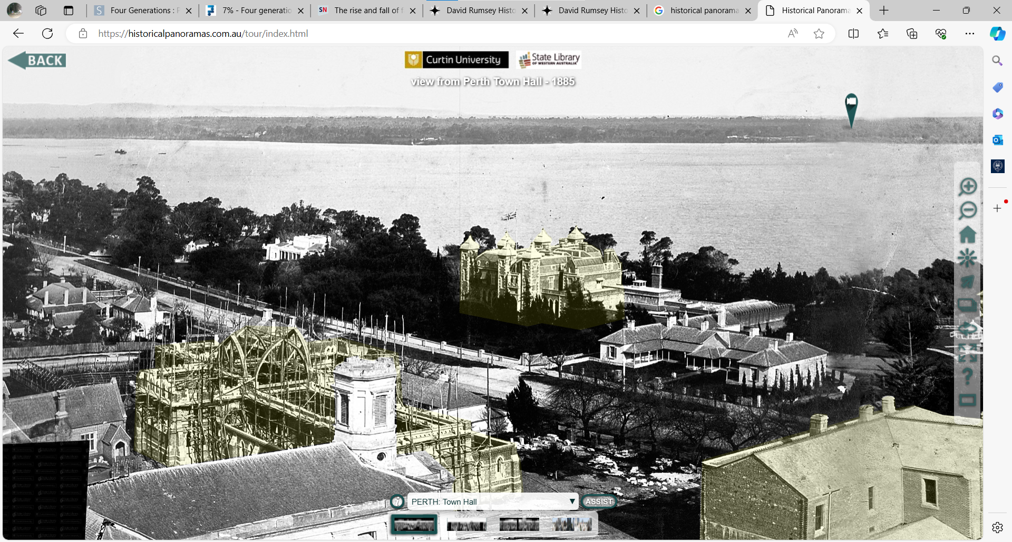

Slide 3
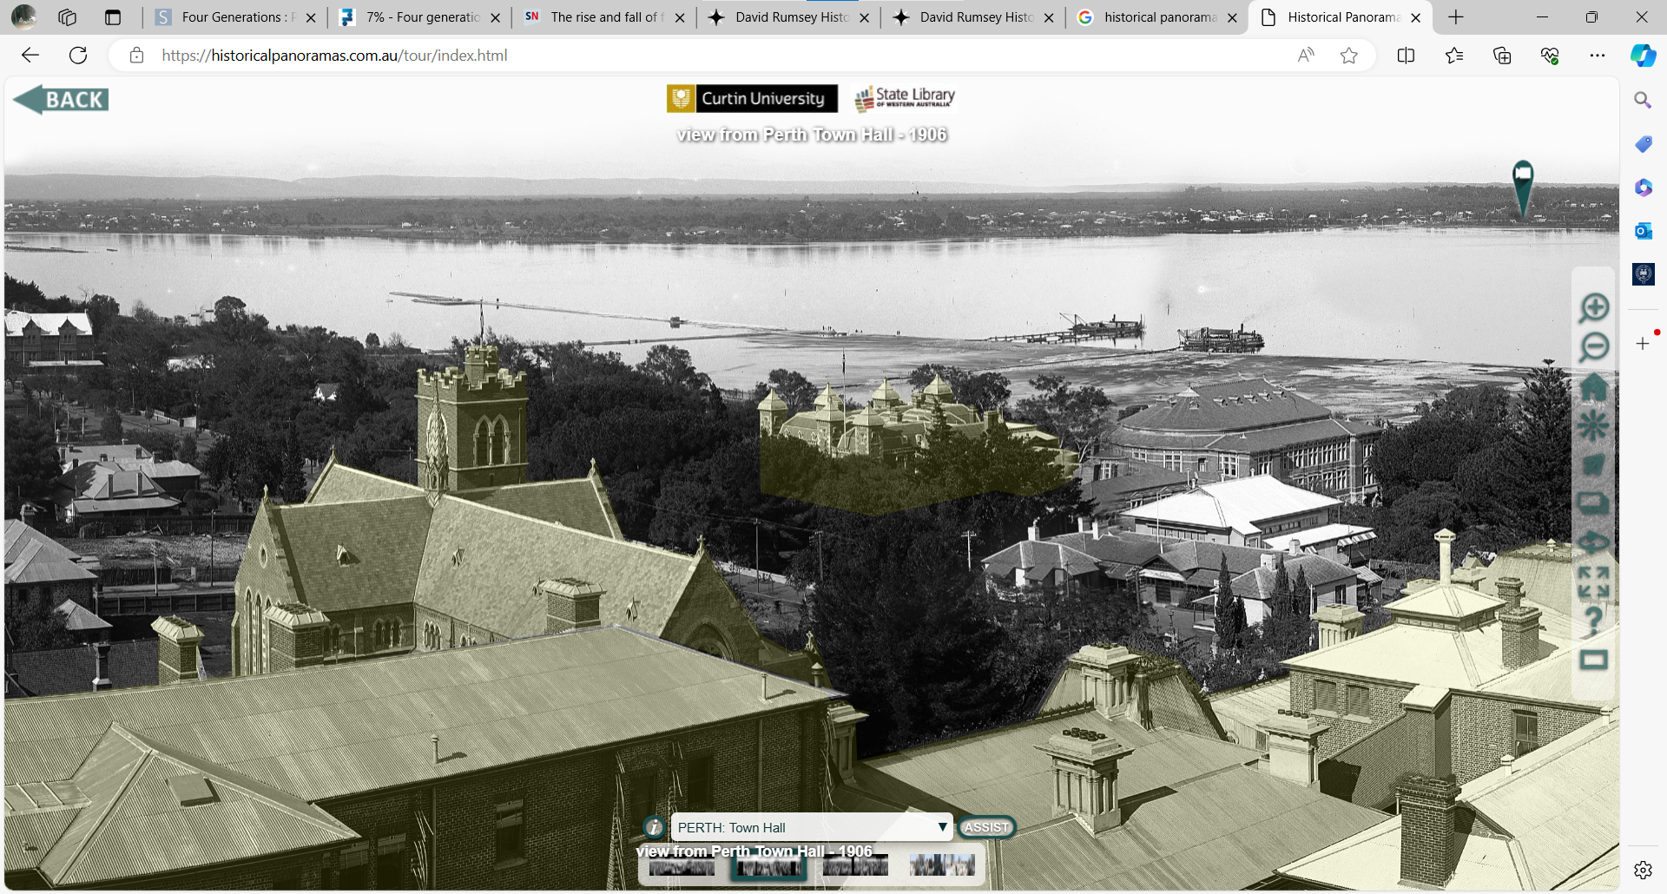

Slide 4
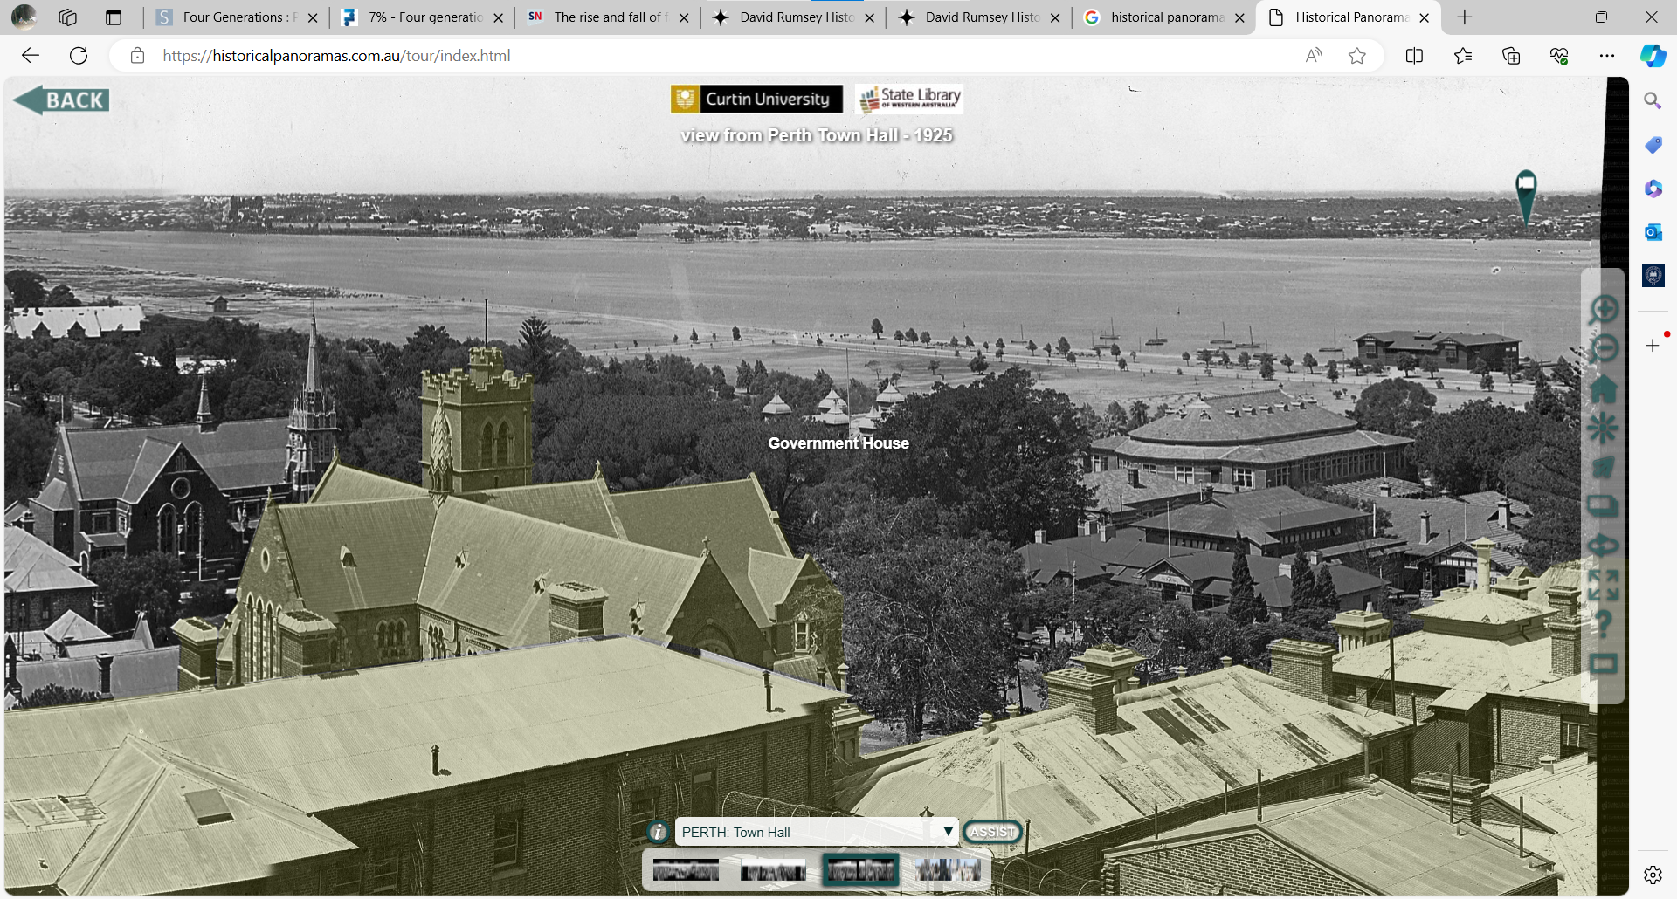

Slide 5
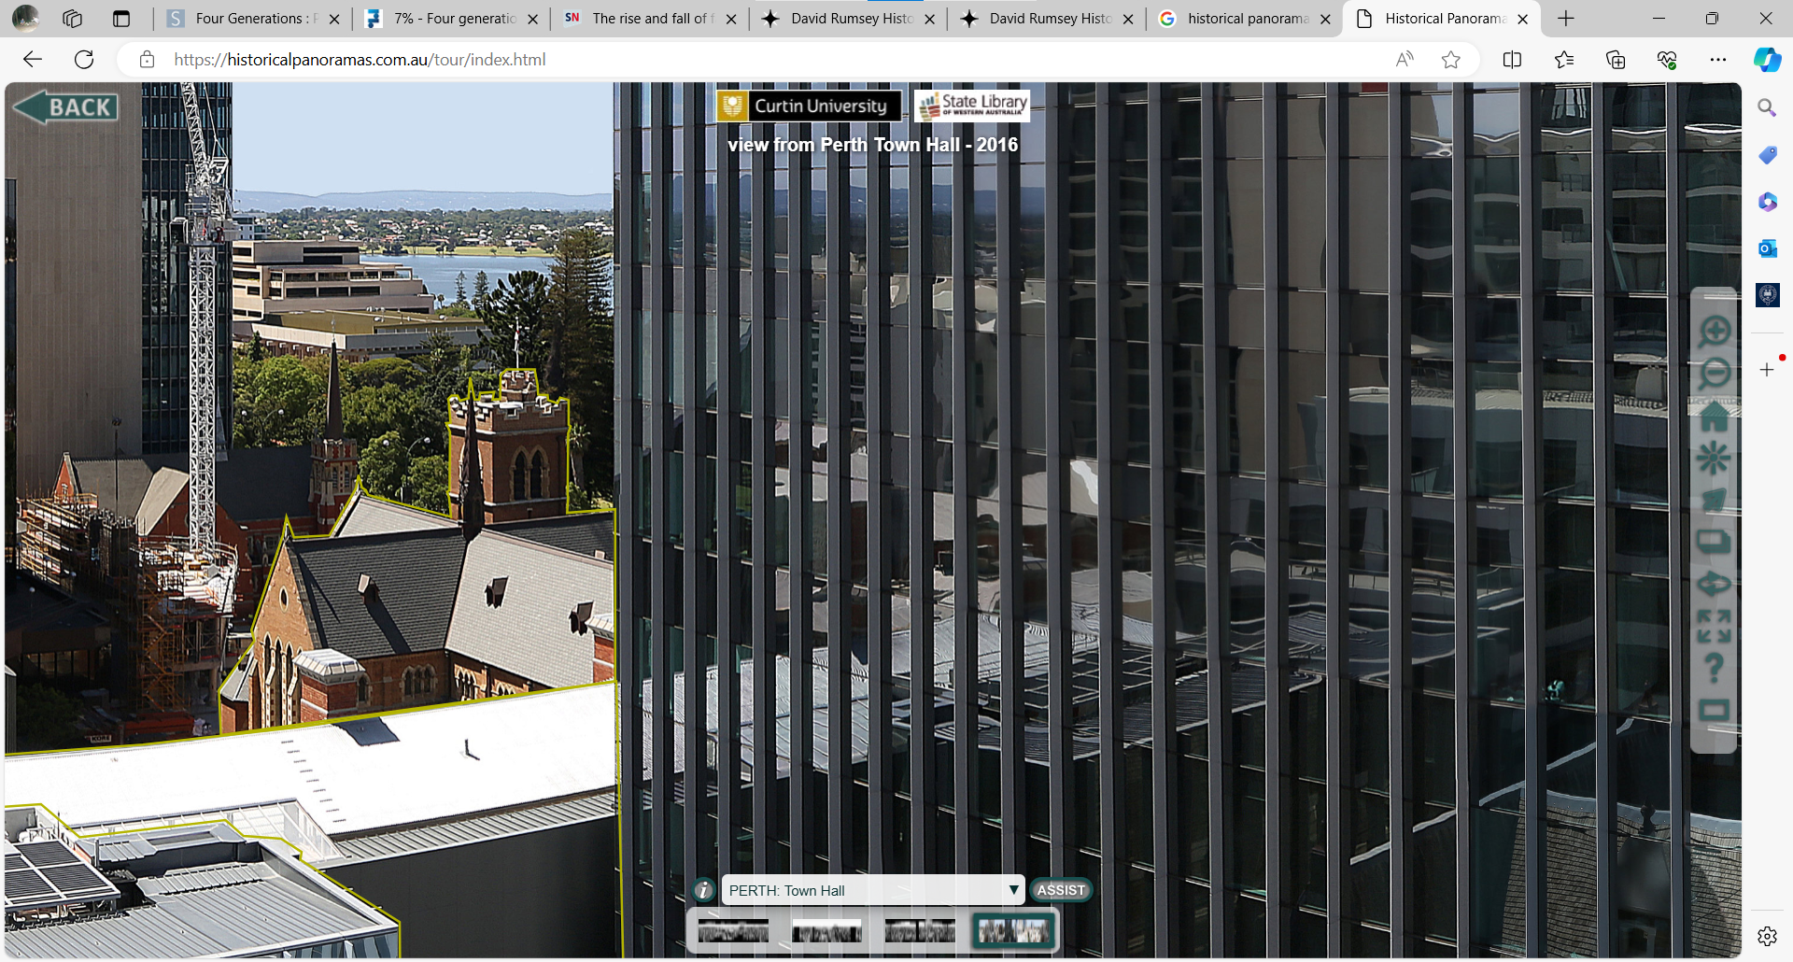

Slide 6
Brief History of Australia
Indigenous Australians from 50,000 to 60,000 years ago
First European voyages in 17th century
Little interest in European settlement
Captain Cook in Botany Bay (Sidney) in 1770
After American Revolution (1775-83), fewer opportunities to transport prisoners to North America
Australia proposed as penal colony, first New South Wales and Tasmania

Slide 7
Brief History of Australia
Majority of early Europeans were former convicts
Convicts worked on public works or were hired to private landowners
After serving sentence (usually seven years), convicts given land
High wages, cheap land, good climate
Sheep

Slide 8
Brief History of Australia
Macquarie (governor 1810-21) believed strongly in rehabilitation of convicts
E.g., Francis Greenway, convict, worked for colonial government as architect
This sometimes conflicted with prevailing practice and social attitudes
E.g., Macquarie allowed convicted lawyers to appear before supreme court

Slide 9
Brief History of Australia
Living standards relatively high
Real wages likely higher and inequality lower even at end of 19th century than U.K., possibly U.S. (Panza and Williamson 2017)
Heights indicate Western Australian convicts were two centimetres taller than free migrants from Britain (Meinzer 2015)

Slide 10
Land and freedom

Slide 11
Land and freedom
Convicts with rare surnames show no trend
Surname method may not be informative of average experiences

Slide 12
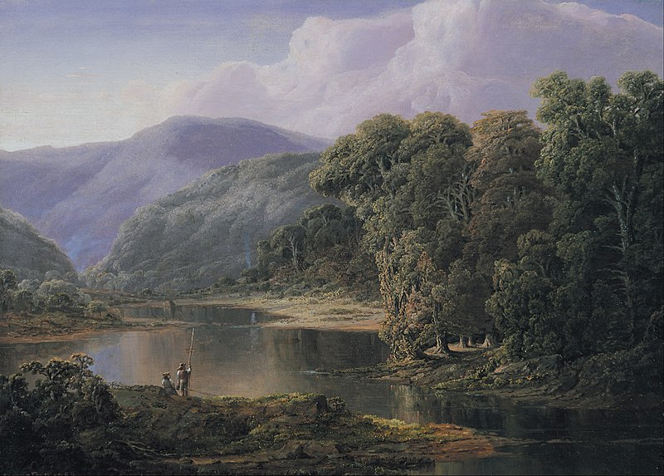
Land(s) of opportunity
When all the privileges of birth and fortune are abolished, when all professions are accessible to all, and a man's own energies may place him at the top of any one of them, an easy and unbounded career seems open to his ambition, and he will readily persuade himself that he is born to no vulgar destinies.
Alexis de Tocqueville (1831)

Slide 13
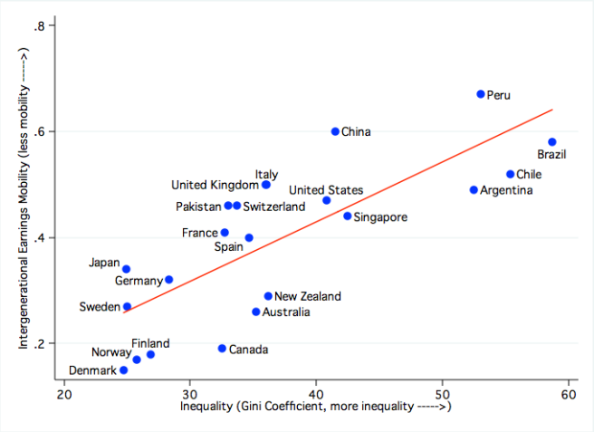
Land(s) of opportunity

Slide 14
Social mobility in land-abundant societies
Alexis de Tocqueville (b. 1805) describes American society as far more socially mobile than Europe
Historically, this was true (e.g. U.S. vs. U.K. vs. Norway)
Why?
Land abundance
Physical mobility (migration)
Fewer personal ties/individualism

Slide 15
Social mobility in land-abundant societies
Define land abundance as a high land-labour ratio
Land important factor of production in agriculture, and important form of wealth
Fixed in the short run, probably in the long run too

Slide 16
Social mobility in land-abundant societies

Slide 17
Land and freedom
Land abundance simultaneously associated with freedom and unfreedom
Slavery in the Americas; Australia as a penal colony
E.g. Michal Howe, ‘Lieutenant Governor of the Woods’, absconding convict lived in the bush, had 100 followers, killed in 1818.
Attempt to understand this seeming contradiction using economics

Slide 18
Land and institutions
Domar (1970) hypothesized that unfree labour would prevail where land-labour ratio was high
Free labour scenario: high wages → rapid savings → buy land → small family farms predominate
Large-scale agriculture only possible with unfree labour

Slide 19
Engerman-Sokoloff Hypothesis
Engerman and Sokoloff (2000) argue that American societies exhibit path dependence from initial agricultural conditions
Industries with economies of scale likely to involve unfree labour in land-abundant societies
Institutions and state shaped by interests of elites

Slide 20
Engerman-Sokoloff Hypothesis
Broadly three possibilities
Caribbean: not suitable to growing grain or sheep but good for sugar (also indigo and tobacco), which exhibit large economies of scale.
Large upfront investment and declining average cost
Very high average incomes but very unequal, majority enslaved
State develops to enforce coerced labour

Slide 21
Engerman-Sokoloff Hypothesis
Spanish mainland colonies
Not strictly plantation-based. Mining and cattle do not exhibit such returns to scale.
However, relatively large indigenous population and pre-colonial institutions taken over, modified by colonists, e.g., Mit’a in Peru
Limited immigration and land granted in large tracts
High inequality

Slide 22
Engerman-Sokoloff Hypothesis
New England & New France
Grain, sheep, mixed small farms
Relative equality

Slide 23
Engerman-Sokoloff Hypothesis

Slide 24
Engerman-Sokoloff Hypothesis
Factor endowment affects distribution of political power and the development of institutions
Inequality persists through land policy (price, parcel size, restrictions), property & legal rights, and immigration policy
Restriction on political participation to maintain privileges
Fewer public goods, particularly education

Slide 25
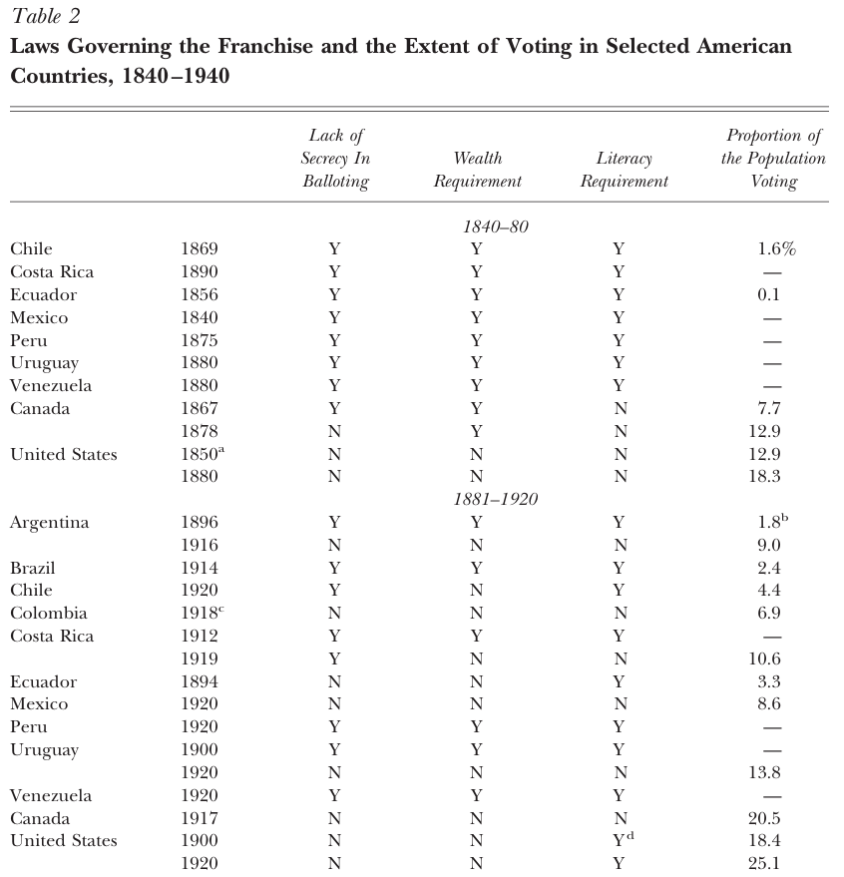
Engerman-Sokoloff Hypothesis

Slide 26
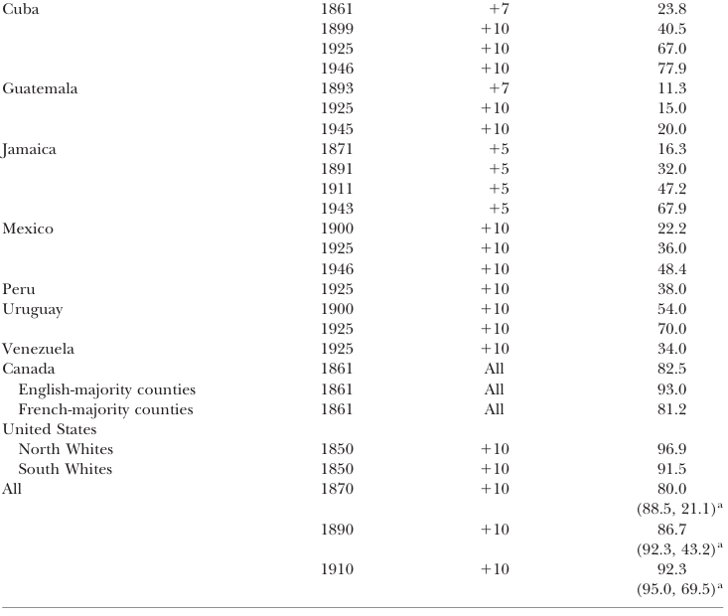
Engerman-Sokoloff Hypothesis

Slide 27
Land(s) of opportunity

Slide 28
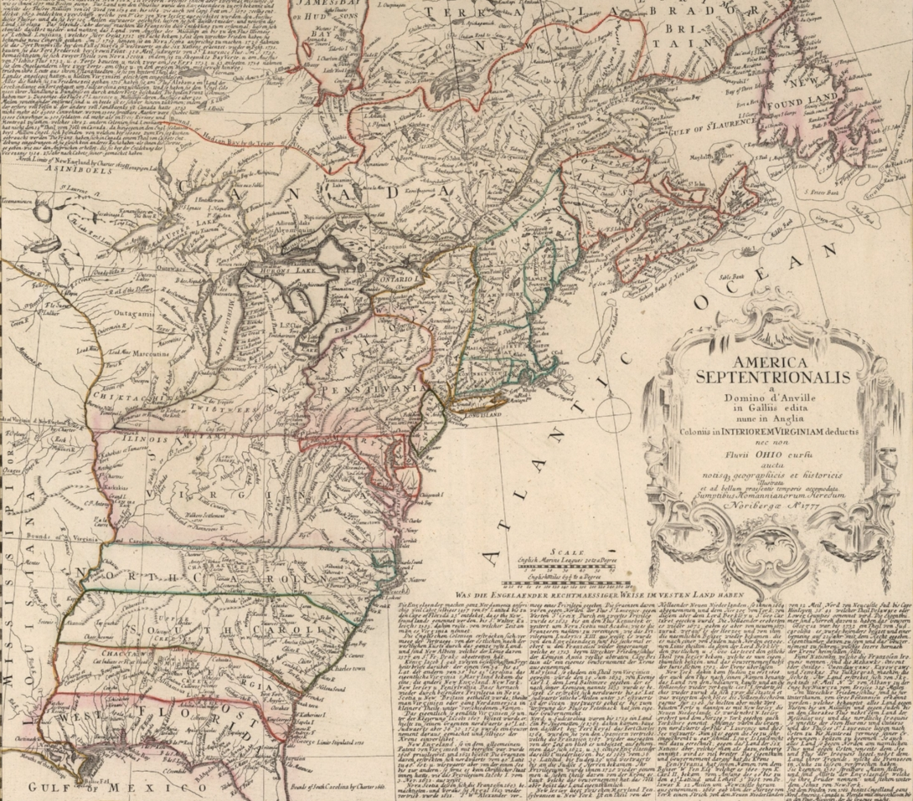
Land abundance in the U.S.
“Frontier”
Royal Proclamation of 1763
Louisiana purchase (1803)
U.S. census declares frontier closed 1890

Slide 29
U.S. Mobility 1860-1990
(Ferrie 2005)

Slide 30
U.S Mobility 1860-1990
U.S. farm sector employs 2/3 of males in 1850
Less than 1/3 in U.K.
Majority of change in 19th c. U.S. mobility driven by farmers

Slide 31
U.S., U.K., and Norway
(Modalisi 2017)

Slide 32
U.S., U.K., and Norway
(Modalsli 2017)

Slide 33
Note on family farms
Majority of agricultural production carried out by family farms
Pollak (1985) describes how this may be efficient
Difficult to monitor agricultural workers against shirking
Family relies on “thick” social connections, implicit threat of expulsion from family is severe
Difficult to exploit economies of scale or hire specialised labour
Farming becomes very capital intensive, may require even more trust

Slide 34
U.S Mobility 1860-1990
(Ferrie 2005)

Slide 35
U.S Mobility 1860-1990
(Ferrie 2005)

Slide 36
More recent mobility in U.S.
Studies of social mobility in U.S. today show trend of lower social mobility continues
Not related to farming (shows up in intergenerational elasticities)
Large regional differences in mobility chances (Chetty et al. 2014) using rank-rank associations

Slide 37
Recent U.S. Mobility
(Chetty et al 2014)

Slide 38
Recent U.S. Mobility
Chetty et al. calculate these slopes for all U.S. commuting zones (approx. 800)

Slide 39
Recent U.S. Mobility
(Chetty et al 2014)

Slide 40
Recent U.S. Mobility
(Chetty et al 2014)

Slide 41
(Chetty et al 2014)

Slide 42
Recent U.S. Mobility
Contemporary Engerman-Sokoloff hypothesis…?
Legacy of slavery and racial discrimination (Jim Crow) reduces quality of public goods (e.g. Wright 2013)

Slide 43
Recent U.S. Mobility
What about migrants to U.S. today?
Large historical project (Abramitzky and Boustan 2022) suggests migrants continue to be more socially mobile
However, explanation has little to do with farming:
Parents’ human capital likely undervalued among first generation migrants
Migrants more likely to move to places with greater opportunities

Slide 44
Thank you!

